Slide 1
My Dream Bot
Create your own dream robot using your robot expertise!
Developed for the AI4GA (Artificial Intelligence for Georgia) project funded by National Science Foundation awards DRL-2049029 and DRL-2048502.
Additional funding was provided by a gift from Google. This work is licensed under the Creative Commons Attribution-NonCommercial-ShareAlike 4.0 International License. https://creativecommons.org/licenses/by-nc-sa/4.0/

Slide 2
Project Expectations
As you design your robot, you will:
Identify at least three (3) physical characteristics
Identify at least three (3) decisions your robot will make about how to accomplish its task
Select at least three (3) sensors
Explain why your robot needs EACH sensor
Explain the need for Edge Detection
Identify the need for Route Finding
Illustrate an example route your robot might travel
Identify the potential societal impact of your robot

Slide 3
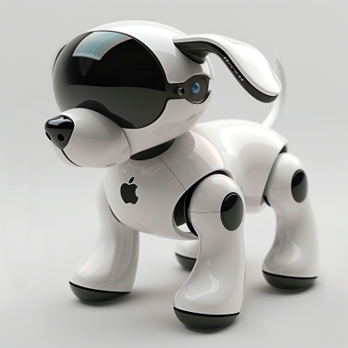
iDoggo
Created by Midjourney prompt “iDoggo a robot dog home companion made by Apple Computer”
My Robot Can
travel with you to be a good friend and guard dog.

Slide 4
Physical Characteristics
Describe your robot:
iDoggo is a metal robot dog.
iDoggo is the size of a german shepherd.
iDoggo has retractable helicopter wings to fly (premium version).

Slide 5


Decisions
Let’s make your dream robot autonomous!
What decisions can your robot make?
iDoggo decides when it should be in protect mode.
iDoggo decides when to wag its tail or whimper.
iDoggo decides when to go recharge.

Slide 6


Sensors
 | Type | Purpose (Why will your robot need each sensor?)
Sensor 1 | Camera | iDoggo uses the camera to recognize its owner so that it only responds to its owner’s commands. iDoggo needs object recognition to navigate around the house without bumping into furniture or walls.
Sensor 2 | Radar | iDoggo uses radar to make sure everyone is safe when crossing the street for walks.
Sensor 3 | Microphone | iDoggo using the microphone to know when its owner is talking to it and respond.

Slide 7
Route Finding
iDoggo mostly works at home. iDoggo can go for walks outside if you buy iDoggo Premium, but default iDoggo only needs to know how to get around the inside of the house. Upload a picture of your house floor plan and iDoggo will make a map and can walk around.

Slide 8
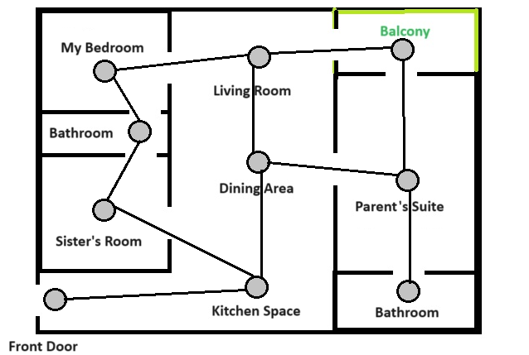

Route Finding
iDoggo needs route finding capabilities to walk around the house and find the best routes between rooms.

Slide 9
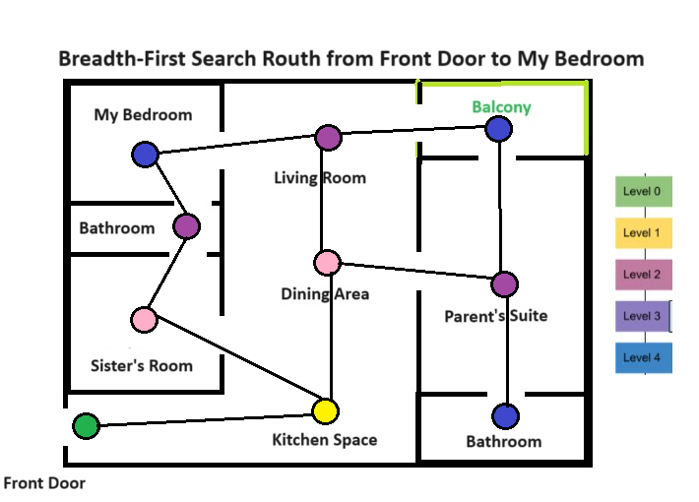
Route Finding

Slide 10
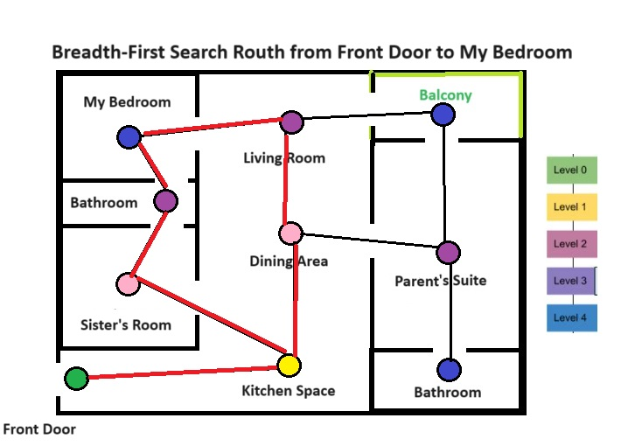
Route Finding
There are 2 possible routes.
Front Door, Kitchen, Sister’s Room, Bathroom, then My Bedroom.
OR
Front Door, Kitchen, Dining Area, Living Room, then My Bedroom.

Slide 11
Possible Societal Impact
Negative
1. People might play more will iDoggo and less with humans.
2. People might not buy as many pets, so dogs will go extinct.
Positive
1. iDoggo does not need to poop/pee so you do not have to worry about cleaning up when you go for walks. The neighborhood will be cleaner.
2. iDoggo can help lonely people feel less alone, and with premium version, taking iDoggo for walks will help people exercise more. Also, instead of training real dogs for blind people, you can program iDoggo.

Slide 12
Labeled Diagram of iDoggo
Camera to see owner and obstacles.
Microphone to hear the owners voice.
Radar for crossing street safely.
Radar for crossing street safely.
Created by Midjourney prompt “iDoggo a robot dog home companion made by Apple Computer”

Slide 13
Project Checklist
As you design your robot, you will:
Identify at least three (3) physical characteristics
Identify at least three (3) decisions your robot will make
Select at least three (3) sensors
Explain the benefits of EACH sensor
Explain the need for Edge Detection
Identify the need for Route Finding
Illustrate an example route your robot might travel
Identify the potential societal impact of your robot

